Slide 1
Indefinite Articles
un
une
des
Un introduces masculine/singular nouns
Une introduces feminine/singular nouns
Des introduces all plural nouns

Slide 2
Indefinite Articles
un
une
des
a/an
a/an
some

Slide 3
Indefinite Articles
______fille
_____ stylo
_____ crayon
_____ carte
_____ papier
_____ fenêtre

Slide 4
_____ ordinateur
_____ livre
_____ poster
_____ chaise
_____ table
_____ pupitre

Slide 5
Plurals of nouns
In many cases you can make the noun plural by adding the letter “s”.
You must change the article to “des”.

Slide 6
some books
some pencils
some pens
des livres
des crayons
des stylos

Slide 7
Plurals of nouns
If a noun ends in “eau”, make that noun plural by adding the letter “x”.
You must change the article to “des”.

Slide 8
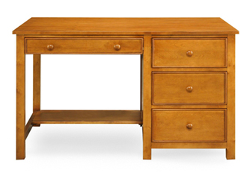




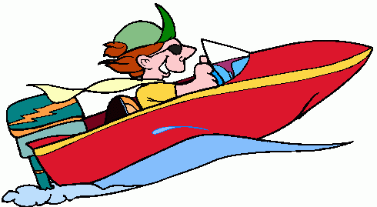
some desks
some (chalk) boards
some hats
some boats
some gifts
some flags
des bureaux
des tableaux
des chapeaux
des bateaux
des cadeaux
des drapeaux

Slide 9
After the expression “pas”, you can omit the article.
You can omit un, une, and des.
After the expression “pas” there are only 2 choices.
Pas de in front of consonants
Pas d’ in front of vowels

Slide 10
de or d’
Il n’y a pas __________ chaise.
Il n’y a pas __________ prof.
Il n’y a pas __________ ordinateur.
Il n’y a pas __________ livre.
Il n’y a pas __________ élève.

